Slide 1
Lecture 6 ADTs Lined Lists
Department of Computer Science
Hofstra University
Acknowledgement: Lecture slides based on UofW Course on Data Structures

Slide 2
Abstract Data Type (ADT) vs. Data Structure
Abstract Data Type (ADT)
A definition for expected operations and behavior
A mathematical description of a collection with a set of supported operations and how they should behave when called upon
Defines the input and outputs, not the implementations
Can be expressed as an interface
Examples: List, Map, Set
Data Structure
A way of organizing and storing related data items
An object that implements the functionality of a specified ADT
Describes how the collection will perform the required operations
Examples: LinkedIntList, ArrayIntList
Notes:
Describes what a collection does, not how it does it

Slide 3
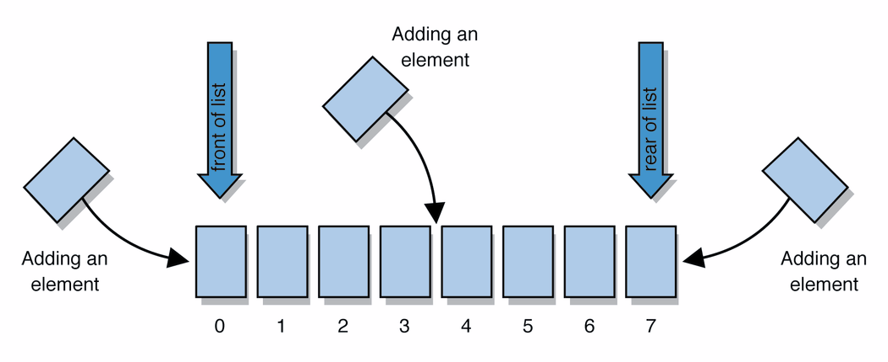
Abstract Data Types (ADT): List Example
Review: List - a collection storing an ordered sequence of elements
each element is accessible by a 0-based index
a list has a size (number of elements that have been added)
elements can be added to the front, back, or elsewhere
the ADT of a list can be implemented many ways through different Data Structures
in Java, a list can be represented as an ArrayList object
Notes:
A way to communicate with other programmers, a standard that we all can agree on so we can discuss conceptual ways of organizing data

Slide 4
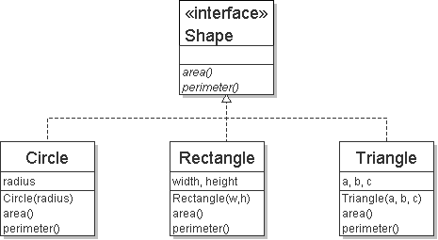
Review: Interfaces
interface: a construct in Java that defines a set of methods that a class promises to implement
Example
// Describes features common to all // shapes.
public interface Shape {
public double area();
public double perimeter();
}
public interface name {
public type name(type name, …, type name );
public type name(type name, …, type name );
…
}
Interfaces give you an is-a relationship without code sharing.
A Rectangle object can be treated as a Shape but inherits no code.
Analogous to non-programming idea of roles/certifications:
"I'm 'certified' as a Shape, because I implement the Shape interface. This assures you I know how to compute my area and perimeter."
"I'm ‘certified’ as a CPA accountant. This assures you I know how to do taxes, audits, and consulting."

Slide 5
Review: Interfaces: List Example
interface: a construct in Java that defines a set of methods that a class promises to implement
// Describes features common to all lists.
public interface List<E> {
public E get(int index);
public void set(E element, int index);
public void append(E element);
public E remove(int index);
…
// many more methods
}
In terms of ADTs, interfaces help us make sure that our implementations of that ADT are doing what they need to
For example, we could define an interface for the ADT List<E> and any class that implements it must have implementations for all of the defined methods

Slide 6
Review: Java Collections
Java provides some DS implementations of ADTs for you!
ADTs
Data Structures
Lists
Stacks
Queues
Maps
List<Integer> a = new ArrayList<Integer>();
Stack<Character> c = new Stack<Character>();
Queue<String> b = new LinkedList<String>();
Map<String, String> d = new TreeMap<String, String>();
But some data structures you made from scratch
Linked Lists - LinkedIntList was a collection of ListNode
Binary Search Trees – SearchTree was a collection of SearchTreeNodes
Notes:
But some data structures you made from scratch
Linked Lists - LinkedIntList was a collection of ListNode
Binary Search Trees – SearchTree was a collection of SearchTreeNodes

Slide 7
ADTs and Data Structures: (Loose) Analogy
An ADT may be implemented with different data structures with different tradeoffs:
Memory vs Speed
Generic/Reusability vs Specific/Specialized
...
Abstract Data Type (ADT)
Data Structures
Mode of Transportation
Must be able to move
Must be able to be steered
Car | Airplane | Bike
Tires | Engines/wings | Wheels
Steering wheel | Control column | Handlebars

Slide 8
ADTs and Data Structures: List Example
List - Abstract Data Type (ADT)
ArrayIntList - Data Structure
// Describes features common to all lists.
public interface List<E> {
public E get(int index);
public void set(E element, int index);
public void append(E element);
public E remove(int index);
…
}
public class ArrayIntList extends List<E>{
private int[] list;
private int size;
public ArrayIntList(){
//initialize fields
}
public int get(int index){
return list[index];
}
public void set(E element, int index){
list[index] = element;
}
…
}

Slide 9
ADTs Examples
List: an ordered sequence of elements
Set: an unordered collection of elements
Map: a collection of “keys” and associated “values”
Stack: a sequence of elements that can only go in or out from one end
Queue: a sequence of elements that go in one end and exit the other
Priority Queue: a sequence of elements that is ordered by “priority”
Graph: a collection of points/vertices and edges between points
Disjoint Set: a collection of sets of elements with no overlap

Slide 10
Case Study: The List ADT
list: a collection storing an ordered sequence of elements
Each item is accessible by an index
A list has a size defined as the number of elements in the list
Expected Behavior:
get(index): returns the item at the given index
set(value, index): sets the item at the given index to the given value
append(value): adds the given item to the end of the list
insert(value, index): insert the given item at the given index maintaining order
delete(index): removes the item at the given index maintaining order
size(): returns the number of elements in the list
List<String> names = new ArrayList<>();
names.add("Anish");
names.add("Amanda");
names.add(0, "Brian");

Slide 11
Case Study: List Implementations
ArrayList
uses an Array as underlying storage
LinkedList
uses nodes as underlying storage
List ADT
ArrayList<E>
LinkedList<E>
state
Set of ordered items
Count of items
state
state
data[]
size
Node front
size
behavior
get(index) return item at index
set(item, index) replace item at index
append(item) add item to end of list
insert(item, index) add item at index
delete(index) delete item at index
size() count of items
behavior
behavior
get return data[index]
set data[index] = value
append data[size] = value, if out of space grow data
insert shift values to make hole at index, data[index] = value, if out of space grow data
delete shift following values forward
size return size
get loop until index, return node’s value
set loop until index, update node’s value
append create new node, update next of last node
insert create new node, loop until index, update next fields
delete loop until index, skip node
size return size
0 | 1 | 2 | 3 | 4
88.6 | 26.1 | 94.4 | 0 | 0
88.6
26.1
94.4
list
free space
Notes:
Code up an implementation of List

Slide 12
Implementing Insert
ArrayList<E>
insert(element, index) with shifting
0 | 1 | 2 | 3
insert(10, 0)
3
4
5
5
10
3
4
3
numberOfItems =
4
LinkedList<E>
insert(element, index) with shifting
insert(10, 0)
10
3
4
5
numberOfItems =
4
3

Slide 13
Implementing Delete
ArrayList<E>
delete(index) with shifting
0 | 1 | 2 | 3
3
4
delete(0)
10
4
5
5
3
numberOfItems =
4
3
LinkedList<E>
delete(index) with shifting
delete(0)
10
3
4
5
numberOfItems =
4
3

Slide 14
Implementing Append
ArrayList<E>
append(element) with growth
0 | 1 | 2 | 3
append(2)
10
3
4
5
numberOfItems =
4
5
0 | 1 | 2 | 3 | 4 | 5 | 6 | 7
10
3
4
5
2
LinkedList<E>
append(element) with growth
append(2)
10
3
4
5
2
numberOfItems =
4
5

Slide 15
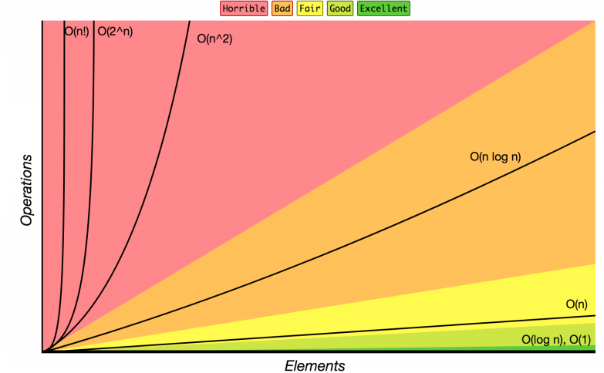
Review: Complexity Class
complexity class: A category of algorithm efficiency based on the algorithm's relationship to the input size N.
Complexity Class | Big-O | Runtime if you double N | Example Algorithm
constant | O(1) | unchanged | Accessing an index of an array
logarithmic | O(log₂ N) | increases slightly | Binary search
linear | O(N) | doubles | Looping over an array
log-linear | O(N log₂ N) | slightly more than doubles | Merge sort algorithm
quadratic | O(N²) | quadruples | Nested loops
... | ... | ... | ...
exponential | O(2^{N}) | multiplies drastically | Fibonacci with recursion

Slide 16
List ADT tradeoffs
ArrayList<Character> myArr
0 | 1 | 2 | 3 | 4
‘h’ | ‘e’ | ‘l’ | ‘l’ | ‘o’
Time needed to access Nth element:
ArrayList:
LinkedList:
Time needed to insert at Nth element (if the array is full!)
ArrayList:
LinkedList:
Amount of space used overall/across all elements
ArrayList:
LinkedList:
Amount of space used per element
ArrayList:
LinkedList:
LinkedList<Character> myLl
O(1) constant time
front
‘h’
‘e’
‘l’
‘l’
‘o’ | /
O(N) linear time
O(N) linear time
O(N) linear time
sometimes wasted space at end of array
compact, one node for each entry
minimal, one element of array
tiny bit extra, object with two fields
Notes:
Last time: we used “slow” and “fast” to describe running times.
Let’s be a little more precise.
Recall these basic Big-O ideas from 12X: Suppose our list has N elements
If a method takes a constant number of steps (like 23 or 5) its running time is O(1)
If a method takes a linear number of steps (like 4N+3) its running time is O(N)
For ArrayLists and LinkedLists, what is the O() for each of these operations?
Time needed to access Nth element
Time needed to insert at end (what if the array is full?)
What are the memory tradeoffs for our two implementations?

Slide 17
A quick aside: Types of memory
Arrays - contiguous memory: when the “new” keyword is used on an array the OS allocates a single, right-sized block of computer memory → Good cache locality
int[] array = new int[3];
array[0] = 3;
array[1] = 7;
array[2] = 3;
0000 | 0001 | 0010 | 0011 | 0100 | 0101 | 0110 | 0111 | 1000 | 1001
 | d672 | 8baf | 020a |  |  |  | 713f | 04e3 | 2e6e
array
3
7
3
Nodes- non-contiguous memory: when the “new” keyword is used on a single node the OS allocates memory space for that object at the next available memory location → Poor cache locality
Node front = new Node(3);
front.next = new Node(7);
front.next.next = new Node(3);
0000 | 0001 | 0010 | 0011 | 0100 | 0101 | 0110 | 0111 | 1000 | 1001 | 1010
 | 4b44 |  |  | 052f | d3cd |  |  | 23d4
front
3
7
3
Notes:
You can see that the array elements are all ‘contiguous’ (right next each other sharing a border) whereas each node object that gets created goes somewhere in memory determined by your computer. It would only be by coincidence that they go next to each other.

Slide 18
ArrayList vs. Linkedlist
ArrayList | LinkedList
ArrayList uses dynamic array to store data items. | LinkedList uses doubly linked list to store data items.
Manipulation with ArrayList is slow. If any element is removed from the array, all the bits are shifted in memory. | Manipulation with LinkedList is fast, since no bit shifting is required.
ArrayList class can act as a list only because it implements List only. | LinkedList class can act as a list and queue both because it implements List and Deque interfaces.
ArrayList is better for storing and accessing data. | LinkedList is better for manipulating data.
ArrayList has less memory overhead, and each index only holds actual data. | LinkedList has more memory overhead, and each node holds both data and references/pointers
ArrayList has good cache locality due to contiguous memory allocation | LinkedList has poor cache locality due to non-contiguous memory allocation
Array
Singly Linked List
Doubly Linked List
head
head
tail
13 | 42 | 51
13
42
51
13
42
51
data
next
data
next
data
next
prev
data
next
prev
data
next
prev
data
next
Notes:
LinkedList
Image viewer
Previous and next images are linked, hence can be accessed by next and previous button
Dynamic memory allocation
We use linked list of free blocks
Implementations of other ADTs such as Stacks, Queues, Graphs, etc.
ArrayList
Maintaining Database Records
List of records you want to add / delete from and maintain your order after
Implementations of other ADTs such as Stacks, Queues, Graphs, etc.

Slide 19
References
Array vs. Single Linked List (In Terms of Representation)
https://www.youtube.com/watch?v=R9PTBwOzceo&list=PLBlnK6fEyqRj9lld8sWIUNwlKfdUoPd1Y&index=31
Linked lists in 4 minutes
https://www.youtube.com/watch?v=F8AbOfQwl1c

Slide 20
Full-Length Lectures
[CSE 373 WI24] Lecture 02: Intro to ADTs
https://www.youtube.com/watch?v=Kpf1xBVZxNg&list=PLEcoVsAaONjd5n69K84sSmAuvTrTQT_Nl&index=1

